Slide 1
Financial Viability Model Petro Kok
21 November 2013

Slide 2
Opening
GREETINGS!
You've received a special delivery from Antoinette & Petro.
CLICK BELOW TO VIEW IT: http://www.jibjab.com/view/jXF5CftLsRPr9coBrJEG
......
YOUR FRIENDS AT NWU

Slide 3
Viability Model: Purpose
What is the top 5 issues we wanted to measure with this model?
Answer:
It is a TOOL to put up flags. Not the Alpha and Omega. It doesn't make a decision.

Slide 4
Viability Model: Purpose
Show the viability and ineffectiveness of different levels (works together with Staff compliment).
Put the focus on non-profitability. Remember: Cross Subsidizing
Helps to answer the "Must or mustn't we?" questions.
Allocation of Resources

Slide 5
Phase 1: Academic Viability
Final Oracle data: (ALL SOF’s)
Income:
Tuition fees
Subsidy (Two years before)
(Capped)
Other Income*
Other Income*
-Investment Income
-Services and Entrepreneurial activities
-Interdepartmental Income
Available on School level
Expenses:
Operating cost
Personnel cost
Capital expenses
Available on School level
School level
(Lowest level)
Excluded:
- Internal transfer accounts (15307, 28201, 30404)
-Residence & catering cost centers
Cost driver: TIU
Faculty Support:
Dean’s office
Cost driver: allocation
Campus Support
Cost driver: allocation
Strategic funds included as allocated.
Institutional Office Support

Slide 6
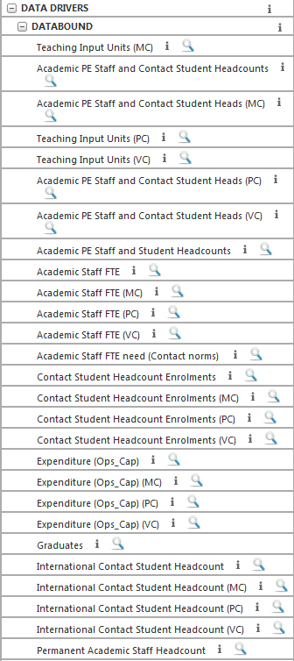
Cost Drivers
Allocation of Support costs
Process
Some examples of cost drivers used
Support costs to be allocated:
1. Faculty support – Deans Office

Slide 7
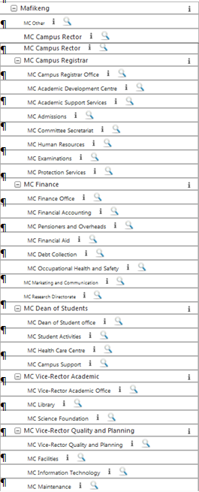
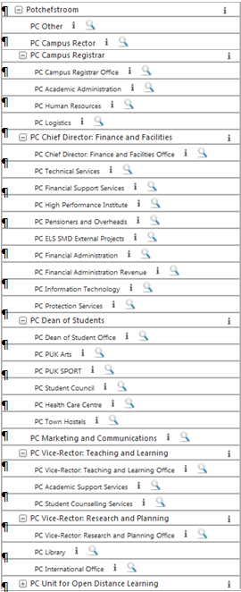
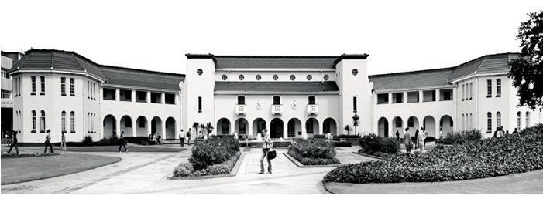
Cost Drivers: Campus Support

Slide 8
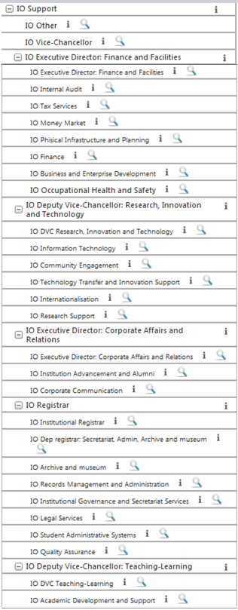
Cost Drivers: IO Support

Slide 9
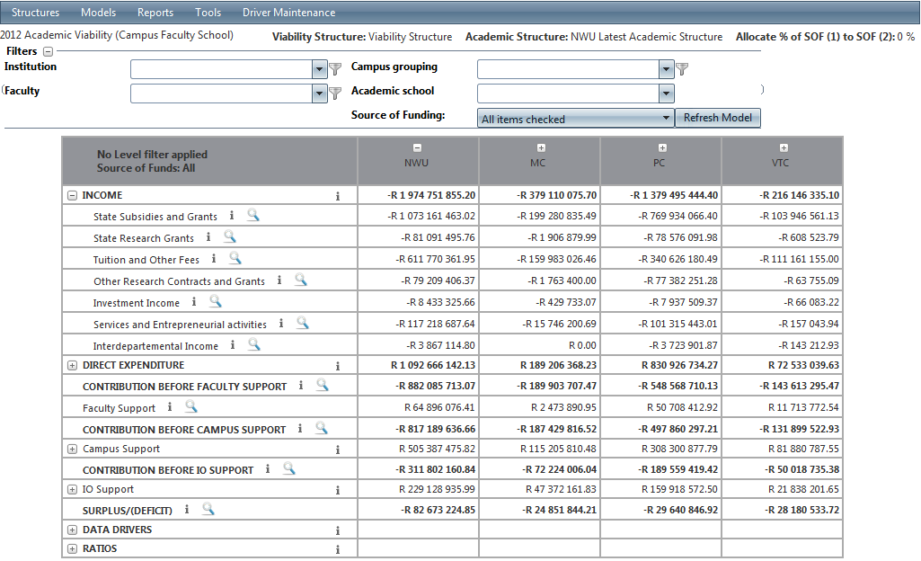
Phase 1: Academic Viability - Example
Filter options
Expand and Collapse data
Problem: Users tend to focus on the wrong level.

Slide 10
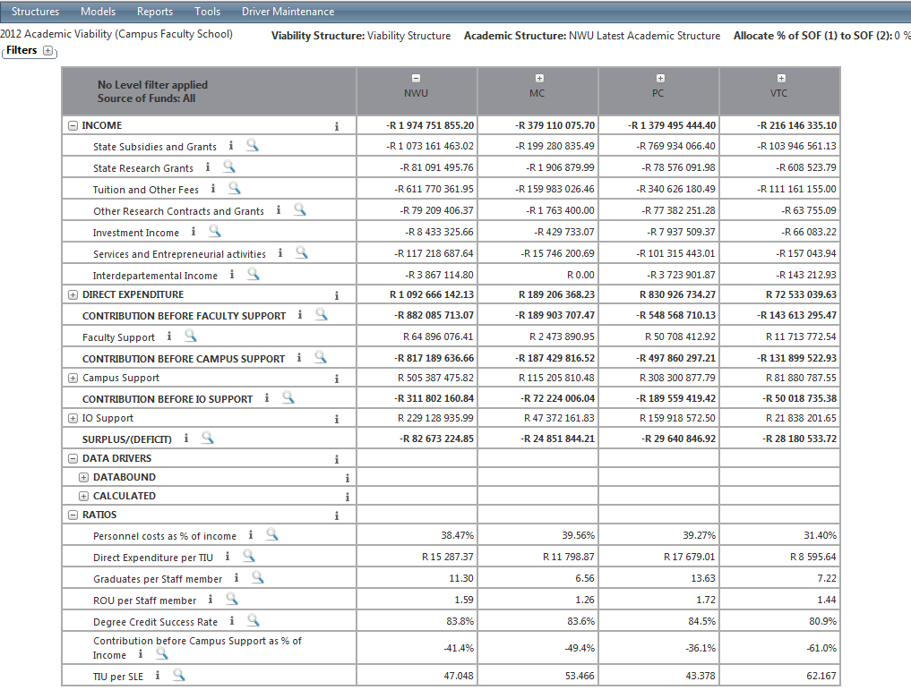
Phase 1: Academic Viability - Example
IDSC can set up different ratios to view in phase 1

Slide 11
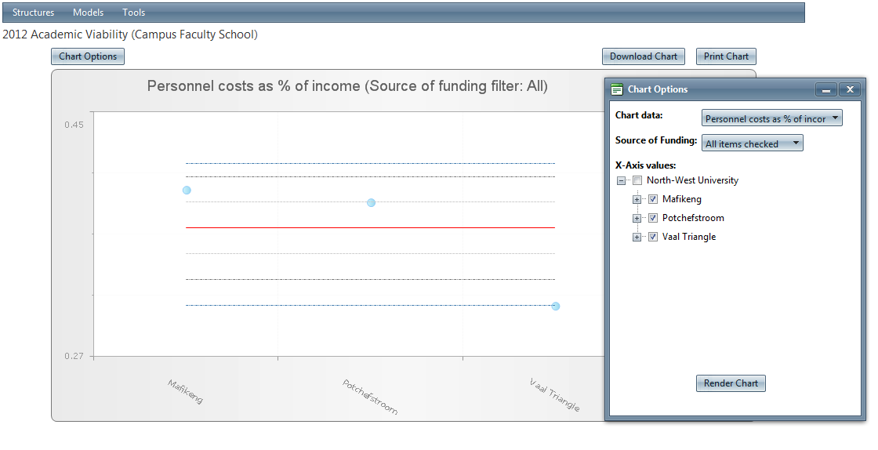
Phase 1: Academic Viability - Example
You can view or create your own charts

Slide 12
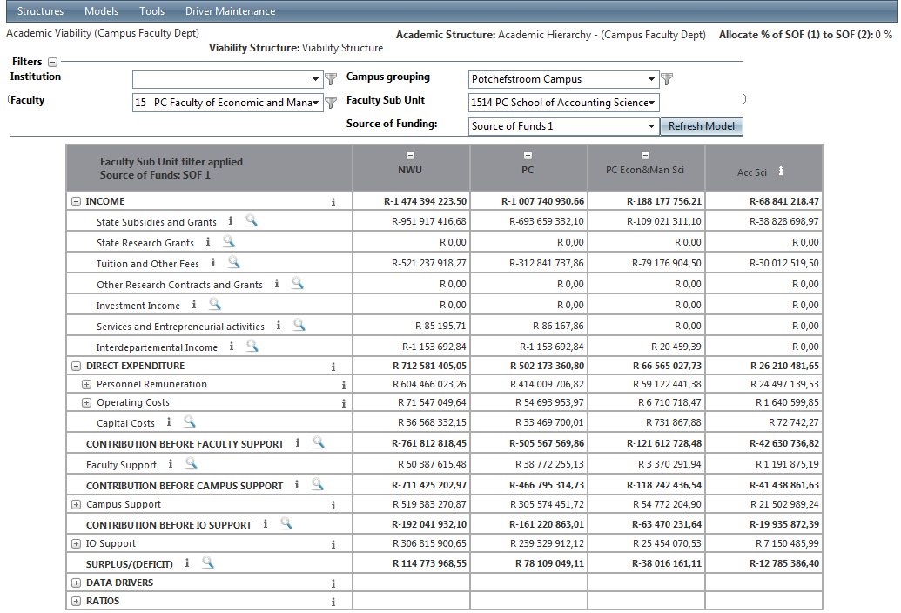
Phase 1: Academic Viability
Filter on SOF 1

Slide 13
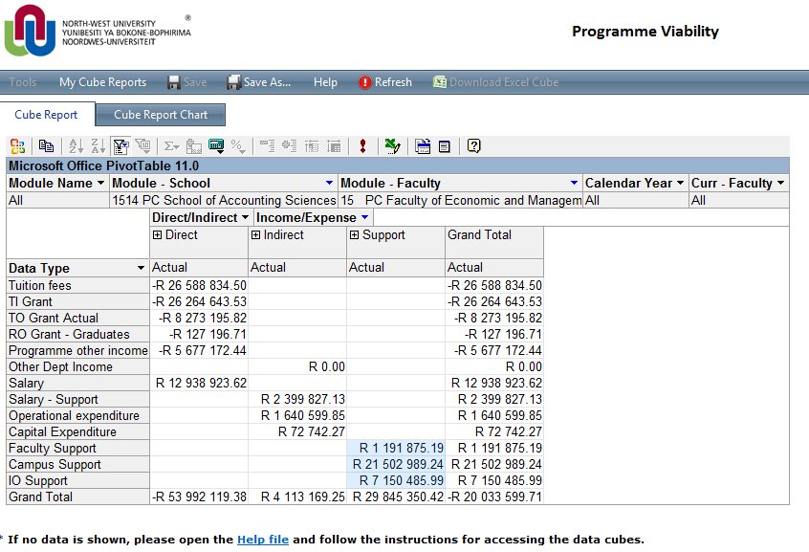
Phase 2: Programme Viability

Slide 14
Phase 2: Programme Viability
Phase 1 can indicate which school needs a more detailed investigation
Phase 2: Programme Viability
Lowest Level: Module level
Data rolls up to Programme level
Needs of a Dean:
Use the data in Budget committee meetings
See the top 10 best/worst modules in a school
See charts on specific programmes within a school
Importance of the Web report

Slide 15
Phase 2: Programme Viability – Data Processing
NB: Module determines where the cost of the department (school) is allocated.
Direct Salaries: The only expense data with information available on module level
All salaries for which we had timesheets and % instruction time, are allocated.
Rest of the direct salary cost without timesheets are not taken into account in phase 2.
For the rest of the cost (not on module level) to be allocated on module level a ratio had to be determined
NEW ACTIVITY**

Slide 16
Phase 2: Programme Viability
NEW ACTIVITY**
The direct salary proportions calculated for the module is used to determine the new activity.
Why use direct salary? It is the only cost for which data is available to link it to
Module level.
This highlights the importance of TIMESHEETS.

Slide 17
Phase 2: Programme Viability (T&L, SOF 1 Only)
From phase 1:
Indirect
Other Income
Operating cost
Capital cost
From phase 1:
Faculty Support
Campus Support
Institutional Office Support
Tuition fees (VSS):
Module enrolment
(Module level)
x NEW ACTIVITY**
x NEW ACTIVITY**
Data available per module
Module level
(Lowest level)
Tuition fees (VSS):
Qualification levy
(Programme level)
Allocation on Fte’s OR TIU
Teaching Input subsidy
-current year uncapped
(based on 2011 HEMIS)
Data available per module
Teaching Output
subsidy – current year
(Programme level)
Allocation on Fte’s OR TIU
x NEW ACTIVITY**
Allocation on Fte’s OR TIU
CTC x %Instruction x %time on module
Research Output subsidy - current year
M & D modules only
(Programme level)
Indirect Support salaries = Total (SOF 1) salaries
phase 1
- Total direct salaries
Direct salaries*

Slide 18
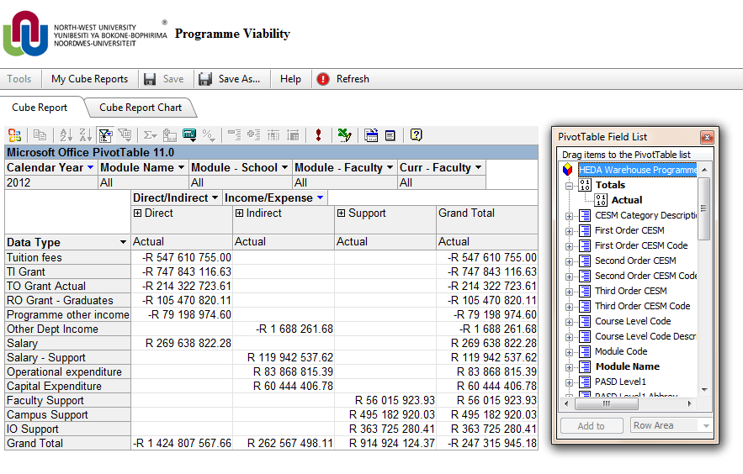
Phase 2: Programme Viability – Cube Report
Works almost like a Pivot table in Excel

Slide 19
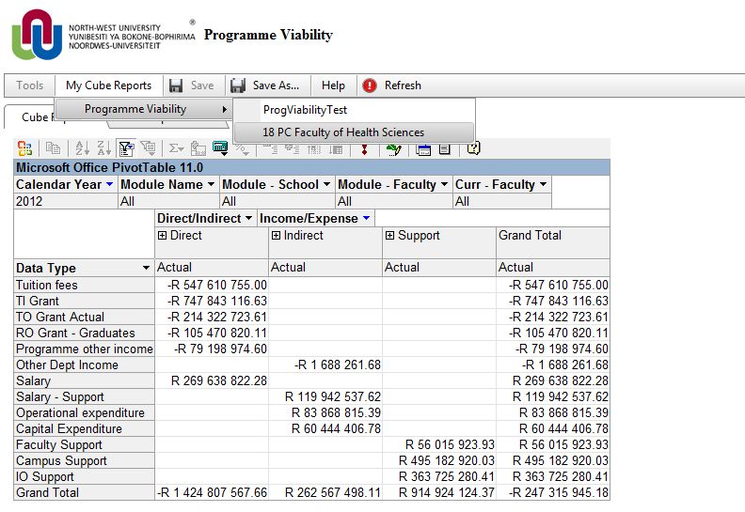
Phase 2: Programme Viability – Cube Report
You can create your own Cube Reports and Save them

Slide 20
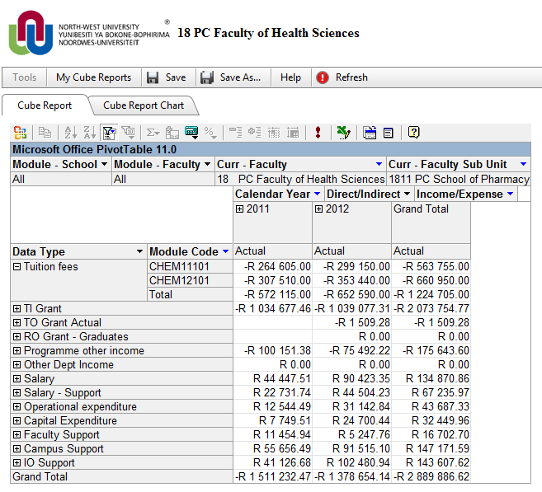
Phase 2: Programme Viability – Cube Report
Drag and drop functionality
Export data to Excel as Pivot table for hand processing
Filter options: Specific School, Module, etc.
A Chart can be rendered from the data selected in this cube

Slide 21
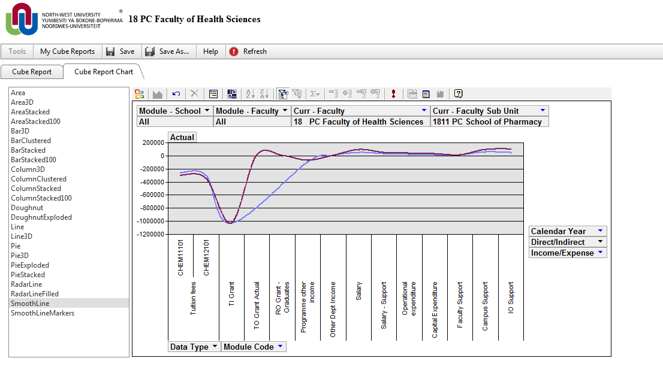
Phase 2: Programme Viability – Cube Chart
Filter options still available.
Cube report and the Cube chart are linked.
Different chart types to choose from

Slide 22
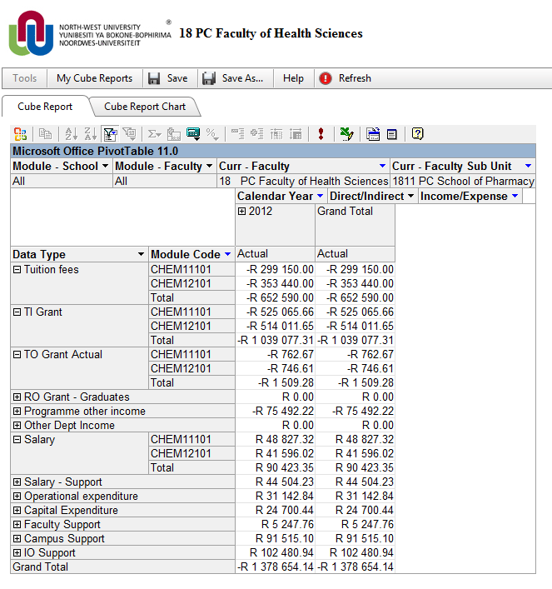
Phase 2: Programme Viability – Cube Report
Link demonstrated:
If you ungroup more rows, change filters etc.

Slide 23
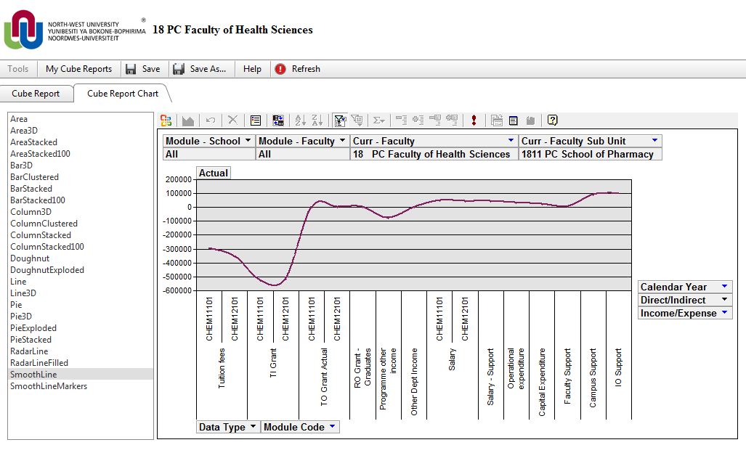
Phase 2: Programme Viability
The change will automatically be made in the Cube chart

Slide 24
Web Report
Great summary of the data
Main report to be used by all users
Still in process of finalising
Want to set up a standard report with 10 items for the end user to view at the click of a button

Slide 25
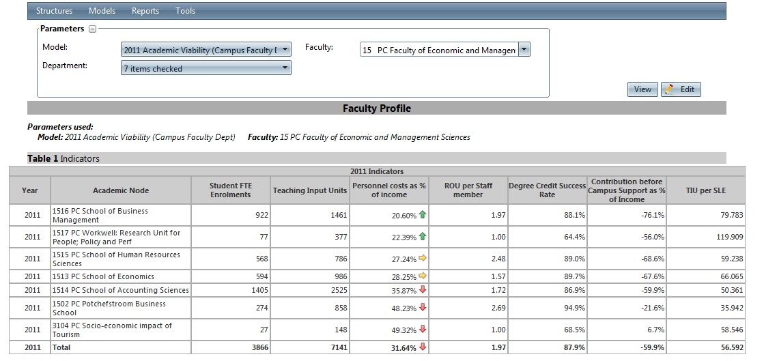
Web Report - Example
Different sections of Web Report:
1. Important indicators to be shown
Academic Nodes shown depends on filter specified

Slide 26
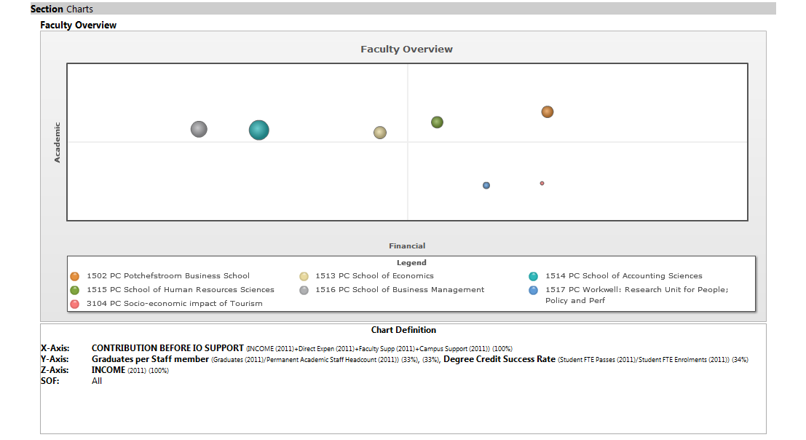
Web Report - Example
2. Numerous charts can be selected to be displayed

Slide 27
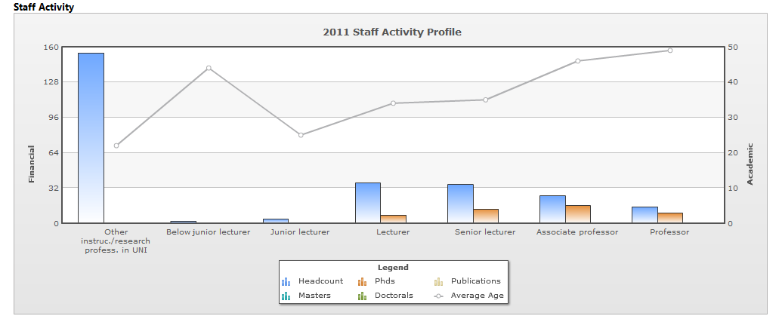
Web Report - Example

Slide 28
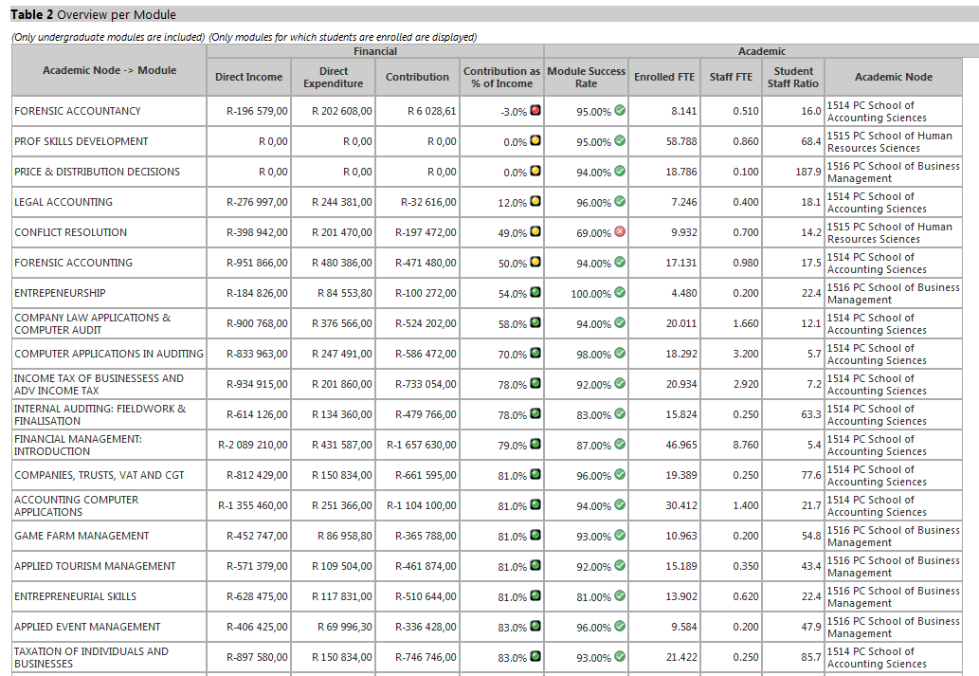
Web Report - Example
3. Display Financial and Academic Indicators

Slide 29
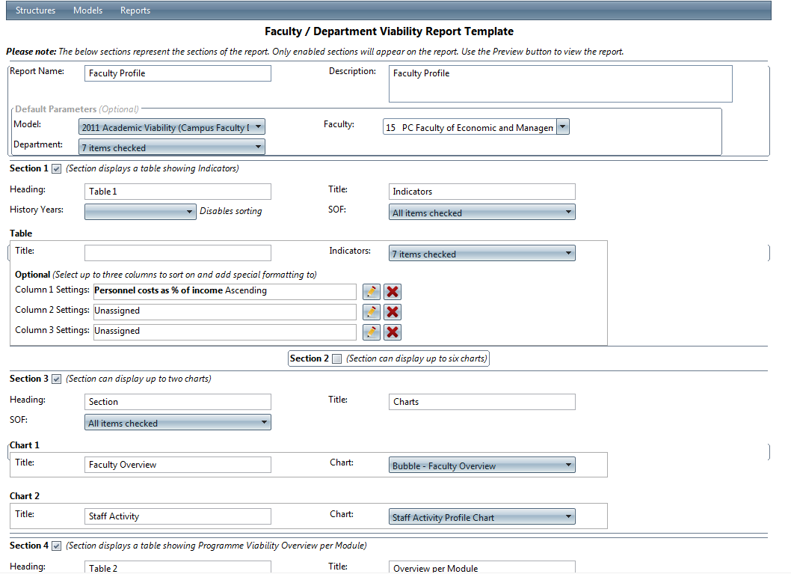
Web Report - Set up
IDSC enabled users to set up web reports to own liking
Different sections as shown in the example

Slide 30
Way forward
Buy-in process of Managers
Continuous Intensive training sessions
Feedback from Deans and Campus finance
Finalise web report
Staff Activity

Slide 31
Questions?

Slide 32
Conclusion
The Viability model is a great management tool.
Thank you IDSC.
You always
CAN (CAN).☺

Slide 33
THANK YOU
GREETINGS!
You've received ANOTHER special delivery from Antoinette and Petro.
CLICK BELOW TO VIEW IT: http://www.jibjab.com/view/JLjApRWfDVH5QbUZjNU1
......
YOUR FRIENDS AT NWU
Thank you

